Slide 1

Stamford Blood Donor System
Group Name Thinker’s
Presented by
Sajib Roy
Faisal Chaklader
Joydeb Paul Anupam

Slide 2
Data Flow Diagram

Slide 3
Decomposition of DFD
Context Level | Level 0 | Level 1
 | 1.0 Admin | CreateModifyAdmin login
 | 2.0 User | InstallCreate profile update Process Server active
Stamford Blood
Donation System | 3.0 Donor | Confirm donateDonate Donor Login
 | 4.0 Gust | InstallProcess Server active

Slide 4
Activites
Admin | User | Gust User | Donor
Add content | User can post | User can post | Tap
Delete content | When blood need | When blood need | Yes/ No
Update Content | Post can edit | Post can edit | Show date last donate blood
 | Post can delete | Post can delete
 | In location wise | In location wise
 | Can call by mobile | Can call by mobile

Slide 5
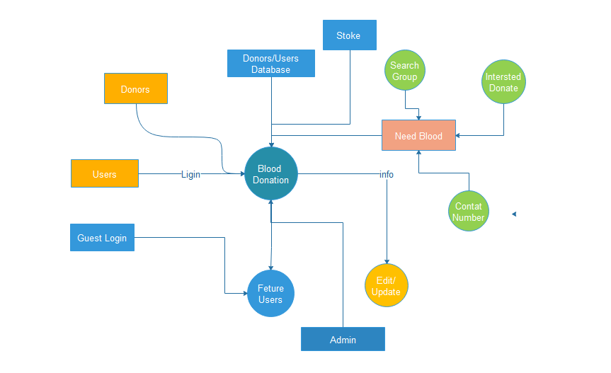
DFD - Context Level

Slide 6
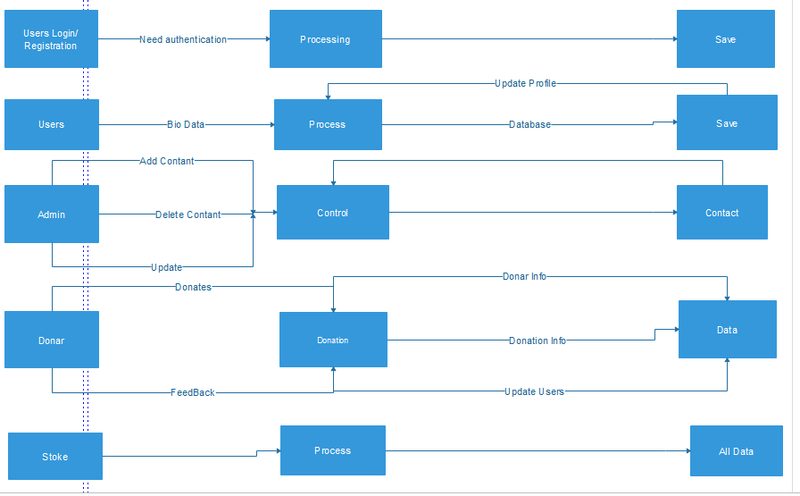
DFD – Level 0

Slide 7
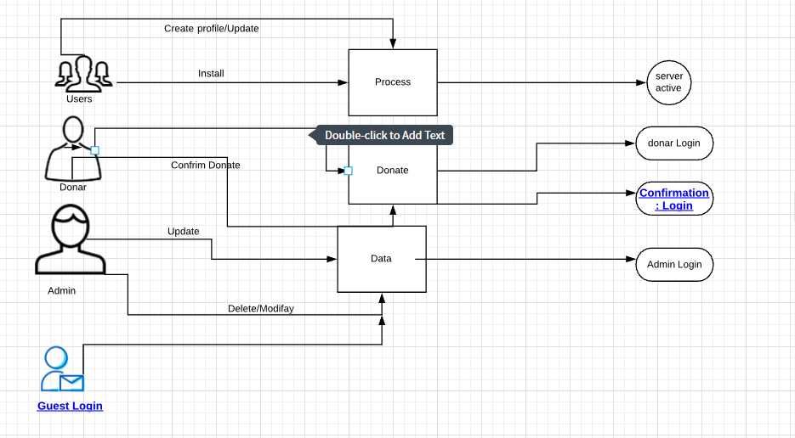
DFD – Level 1

Slide 8
Thank you

